Slide 1
Week 10

Slide 2
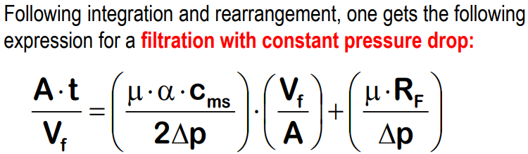



Exercise 2.3: Filtration of calcium silicate
Calcium silicate particles have been filtered on a paper disk 9 cm in diameter and at two different values of ∆p, namely 69 and 138 kPa. The liquid is water at 20 °C, which has the following properties: ρ = 0.9982 g/cm3, μ = 1.0 mPa·s. The solid concentration in the suspension, Cms, is 50 kg/m3. The filtrate volume has been registered as a function of time. The corresponding data are in the table below.
$∆p$=69kPa,
$∆p$=138kPa,
t [s] | 0.0 | 2.0 | 5.0 | 8.6 | 15.1 | 21.8 | 39.9 | 66.0 | 95.7
V_{f} [L] | 0.000 | 0.096 | 0.198 | 0.294 | 0.398 | 0.497 | 0.698 | 0.900 | 1.098
t [s] | 0.0 | 2.0 | 4.5 | 7.0 | 15.8 | 28.6 | 45.0 | 63.3 | 82.0
V_{f} [L] | 0.000 | 0.104 | 0.203 | 0.304 | 0.507 | 0.702 | 0.903 | 1.106 | 1.202
Determine the filter resistance RF and the cake specific resistance α for each trial.
∆p=69kPa
t [s] | 0 | 2 | 5 | 8.6 | 15.1 | 21.8 | 39.9 | 66 | 95.7
V_{f} [L] | 0 | 0.096 | 0.198 | 0.294 | 0.398 | 0.497 | 0.698 | 0.9 | 1.098
V_{f} [m^3] | 0 | 0.000096 | 0.000198 | 0.000294 | 0.000398 | 0.000497 | 0.000698 | 0.0009 | 0.001098
Vf/A [m] |  | 0.01509026 | 0.031124 | 0.046214 | 0.0625617 | 0.078124 | 0.109719 | 0.141471 | 0.172595
A*t/Vf [s/m] |  | 132.535828 | 160.6495 | 186.0911 | 241.3617292 | 279.0453 | 363.657 | 466.5261 | 554.4778
∆p=138kPa
t [s] | 0 | 2 | 4.5 | 7 | 15.8 | 28.6 | 45 | 63.3 | 82
V_{f} [L] | 0 | 0.104 | 0.203 | 0.304 | 0.507 | 0.702 | 0.903 | 1.106 | 1.202
V_{f} [m^3] | 0 | 0.000104 | 0.000203 | 0.000304 | 0.000507 | 0.000702 | 0.000903 | 0.001106 | 0.001202
Vf/A [m] |  | 0.01634778 | 0.03191 | 0.047786 | 0.079695431 | 0.110348 | 0.141943 | 0.173852 | 0.188943
A*t/Vf [s/m] |  | 122.340764 | 141.0233 | 146.487 | 198.2547772 | 259.1812 | 317.0292 | 364.102 | 433.9942

Slide 3
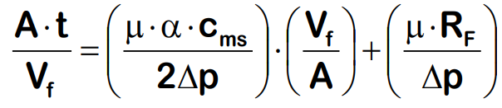

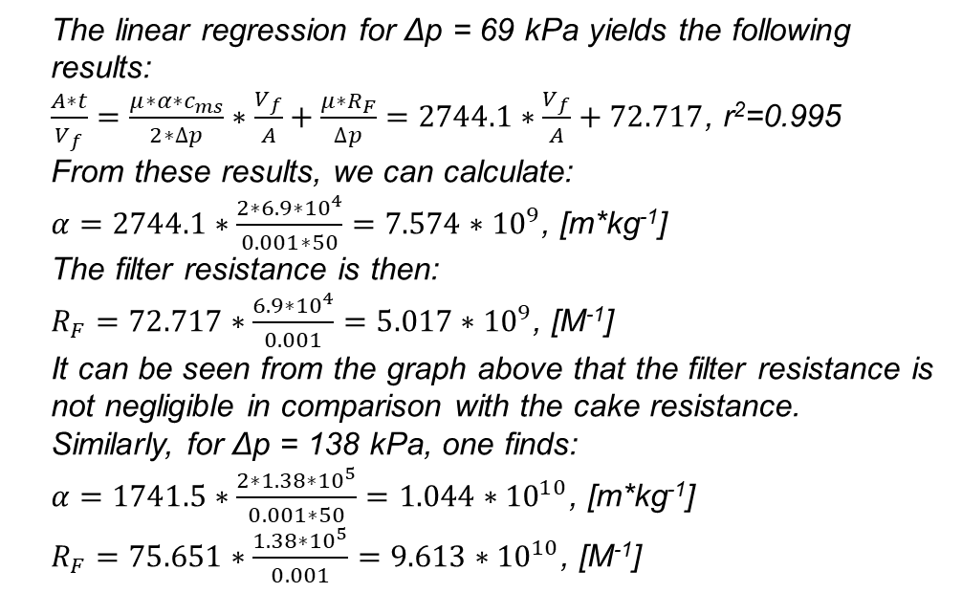
The linear regression for Δp = 69 kPa yields the following results:
$\frac{A∗t}{V_{f}}=\frac{μ∗α∗c_{ms}}{2∗∆p}∗\frac{V_{f}}{A}+\frac{μ∗R_{F}}{∆p}=2744.1∗\frac{V_{f}}{A}+72.717$, r²=0.995
From these results, we can calculate:
$α=2744.1∗\frac{2∗6.9∗{10}^{4}}{0.001∗50}=7.574∗{10}^{9}$, [m*kg⁻¹]
The filter resistance is then:
$R_{F}=72.717∗\frac{6.9∗{10}^{4}}{0.001}=5.017∗{10}^{9}$, [M⁻¹]
It can be seen from the graph above that the filter resistance is not negligible in comparison with the cake resistance.
Similarly, for Δp = 138 kPa, one finds:
$α=1741.5∗\frac{2∗1.38∗{10}^{5}}{0.001∗50}=1.044∗{10}^{10}$, [m*kg⁻¹]
$R_{F}=75.651∗\frac{1.38∗{10}^{5}}{0.001}=9.613∗{10}^{10}$, [M⁻¹]
2. Is the cake of a compressible nature?
incompressible
compressible
It can be seen that the value of α does not change significantly from 69 to 138 kPa. The calculated value for the cake compressibility n is ca. 0.22, which effectively corresponds to a fairly incompressible cake.

Slide 4
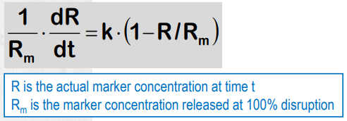
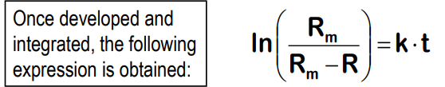
Exercise 2.4: Lysis kinetics in a bead mill
Schütte & Kula (1990)(1) have lysed Bacillus cereus cells in a bead mill and measured the activity of the released L-Leucine dehydrogenase (LDH) in the liquid phase as a function of treatment duration. The results are given in the table below:
t [min] | 0.10 | 0.35 | 1.00 | 1.67 | 3.00 | 5.09 | 8.10 | 13.03
LDH [U/mL] | 1.15 | 4.15 | 9.08 | 14.7 | 21.62 | 28.97 | 33.73 | 36.32
Assuming lysis kinetics is first order, determine the value of the kinetic constant.
The problem with that kind of linearization is that one needs to give an estimate for the maximal value of the measured variable, Rm, (here the enzyme activity concentration) to be able to do the regression. This is a bit strange since Rm is one of the model parameters. In the present case, Rm = 37.1 [U/ml] gave the best linearity (R²=0.9999).

Slide 5
t [min] | 0.1 | 0.35 | 1 | 1.67 | 3 | 5.09 | 8.1 | 13.03
LDH [U/mL] | 1.15 | 4.15 | 9.08 | 14.7 | 21.62 | 28.97 | 33.73 | 36.32
ln (R m/(Rm-R)) | 0.03148 | 0.11863 | 0.2807 | 0.50456 | 0.87407 | 1.51806 | 2.3987 | 3.86208
Make a plot of ln(R m/(Rm-R)) = f(t):
2. What is the main complication with linearizations of the form ln (R m/(Rm-R)) = k·t ?
The problem with that kind of linearization is that one needs to give an estimate for the maximal value of the measured variable, Rm, (here the enzyme activity concentration) to be able to do the regression.
If a non-linear regression is performed, this problem can be avoided since both parameters can be optimized simultaneously. The result is Rm = 36.83 [U/ml] and k = 0.289 [min-1].
k=0.2964 min⁻¹

Slide 6
Exercise 2.5: Cell lysis in a high pressure homogenizer
Cell lysis of a yeast suspension was achieved using a high pressure homogenizer at different pressures. The results are given in the graph below under the linear form corresponding to the Hetherington equation.
1. How many passages N would you need to reach 90% lysis at each pressure? (take N as a continuous variable)
2. What minimal pressure would you need to achieve 75% lysis after three passages?
Reminder: 1 kg/cm2 = 0.981 bar

Slide 7
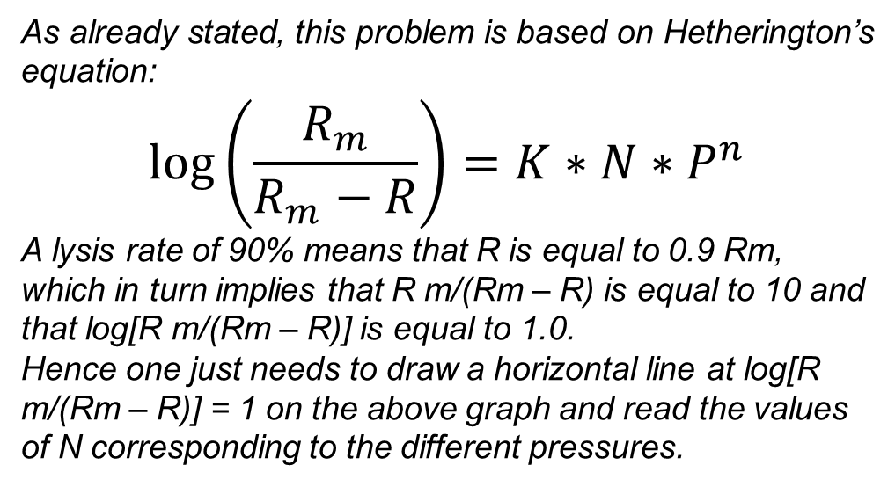
1. How many passages N would you need to reach 90% lysis at each pressure? (take N as a continuous variable)
As already stated, this problem is based on Hetherington’s equation:
$$\log\left(\frac{R_{m}}{R_{m}−R}\right)=K∗N∗P^{n}$$
A lysis rate of 90% means that R is equal to 0.9 Rm, which in turn implies that R m/(Rm – R) is equal to 10 and that log[R m/(Rm – R)] is equal to 1.0.
Hence one just needs to draw a horizontal line at log[R m/(Rm – R)] = 1 on the above graph and read the values of N corresponding to the different pressures.

Slide 8
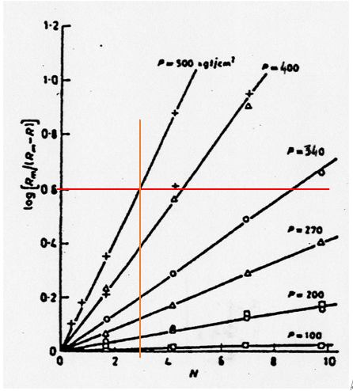
2. What minimal pressure would you need to achieve 75% lysis after three passages?
With 75% lysis, log[R m/(Rm – R)] is equal to 0.602. To answer the question graphically we can draw a vertical line at N=3 and a horizontal line at log[R m/(Rm – R)] = 0.602.
We then see that the required pressure lies pretty close to 500 kg/cm2 or 491 bar.
To obtain a more precise answer we need to know the values of K and n in the Hetherington
equation. This can be obtained by plotting the log of the K *Pn values in the table above as a function of logP. This is done below:
log⁡(R_m/(R_m-R))=0.602=KNP^n=2.16272*〖10〗^(-9)*3*P^2.9872
P = 465 [Pa]

